Slide 1



COMMUNICATE COLLABORATE CREATE
INTER-YEAR CONNECT
HS202 : HUMAN GEOGRAPHY AND SOCIETAL NEEDS
8 APRIL 2024

Slide 2

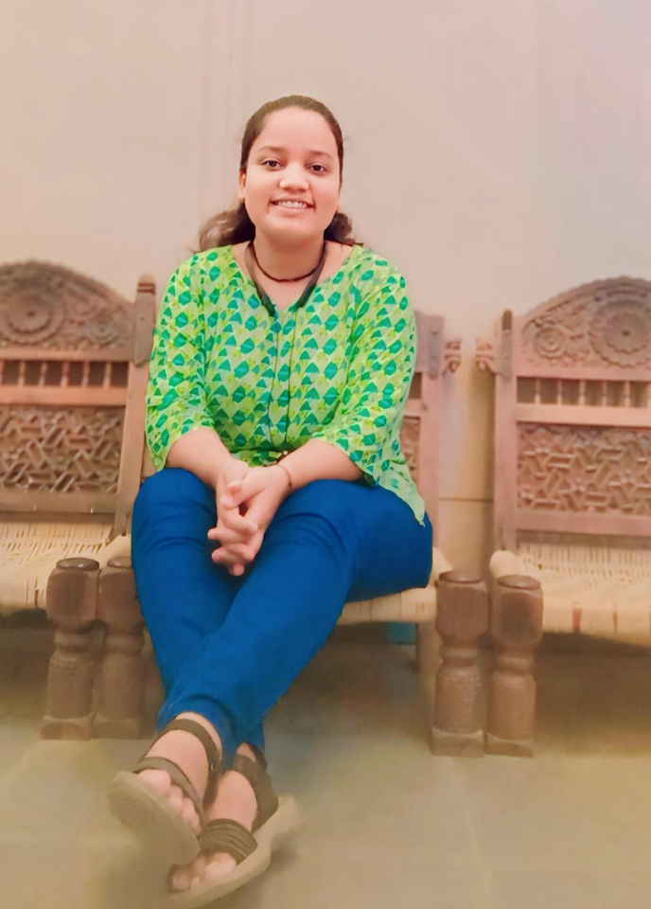
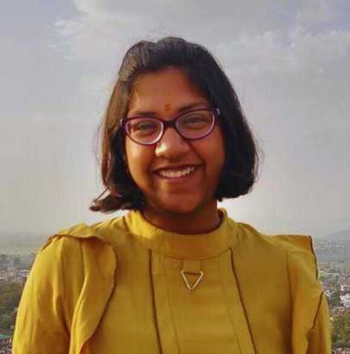
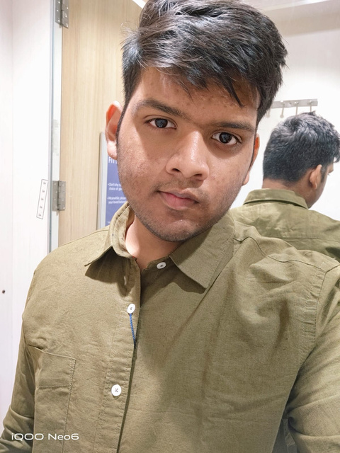
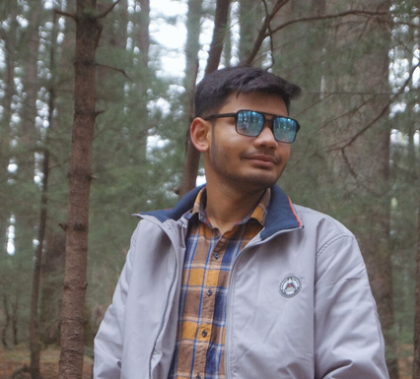
COMMUNICATE COLLABORATE CREATE
Our Team
Chahat
Aditi Garg
Arnav Maitreya
Priyanshu Gupta
2022MEB1046
2022MEB1289
2022MEB1299
2022MEB1330

Slide 3
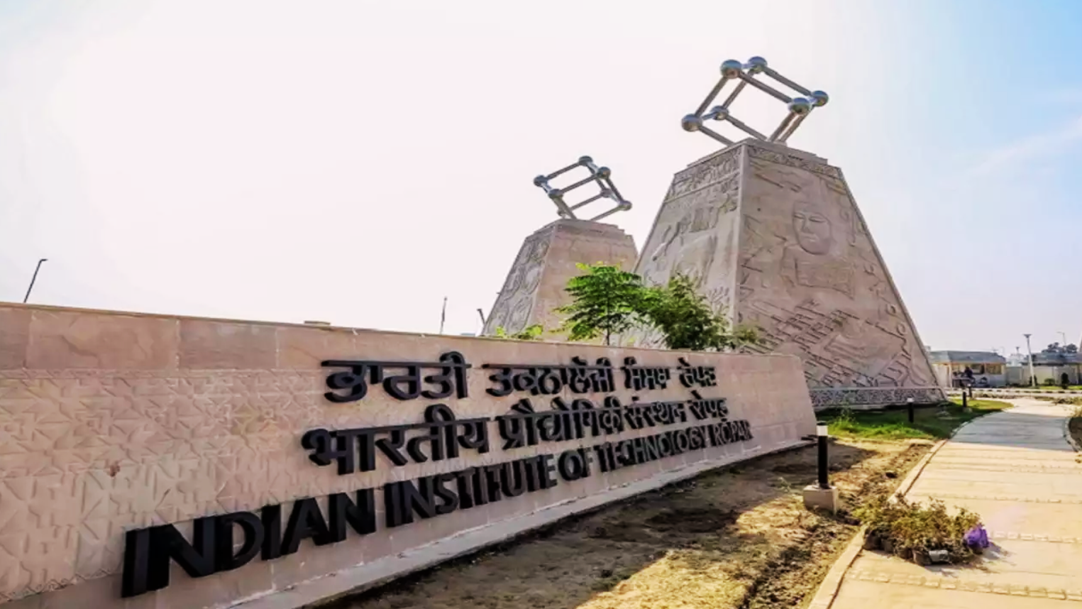
The Generation of Aspiration and Challenge
Generation of students with insatiable curiosity and grand aspirations
The aspiration vs. confusion paradox
The invaluable role of senior wisdom and mentorship

Slide 4
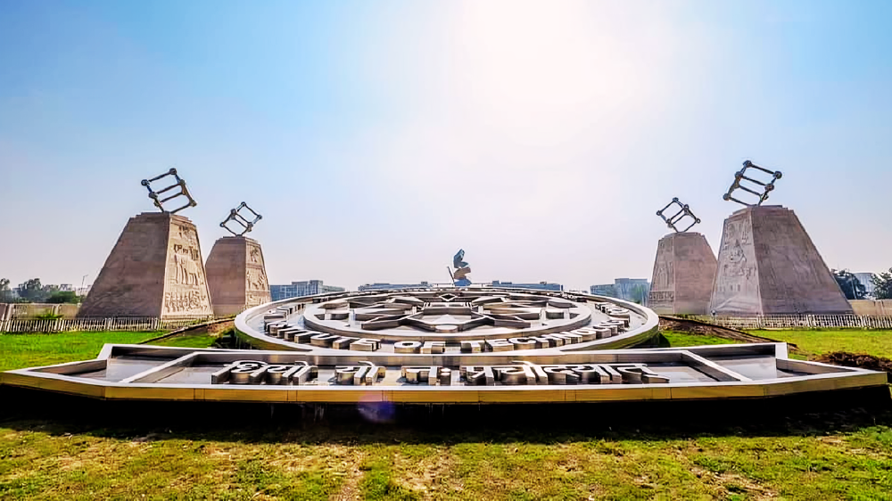
The Gap in Our Community
PROBLEM STATEMENT
Lack of inter-year interaction: A barrier to holistic development
Consequences of a disconnected community
The need for bridging academic years

Slide 5
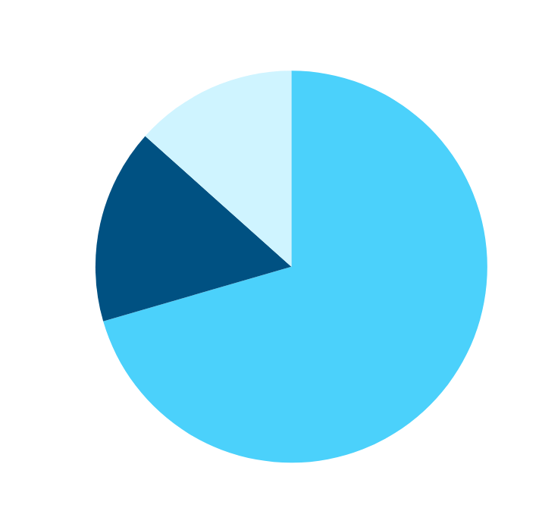
COMMUNICATE COLLABORATE CREATE
Evidence Through Survey
Do you perceive a divide between undergraduate and post-graduate students in terms of social interaction on campus?

Slide 6

ORIGIN OF THE PROBLEM:
Unraveling the Roots
Segmented academic programs and busy schedule
01
Social dynamics and cliques at play
02
Lack of awareness and opportunities
03

Slide 7
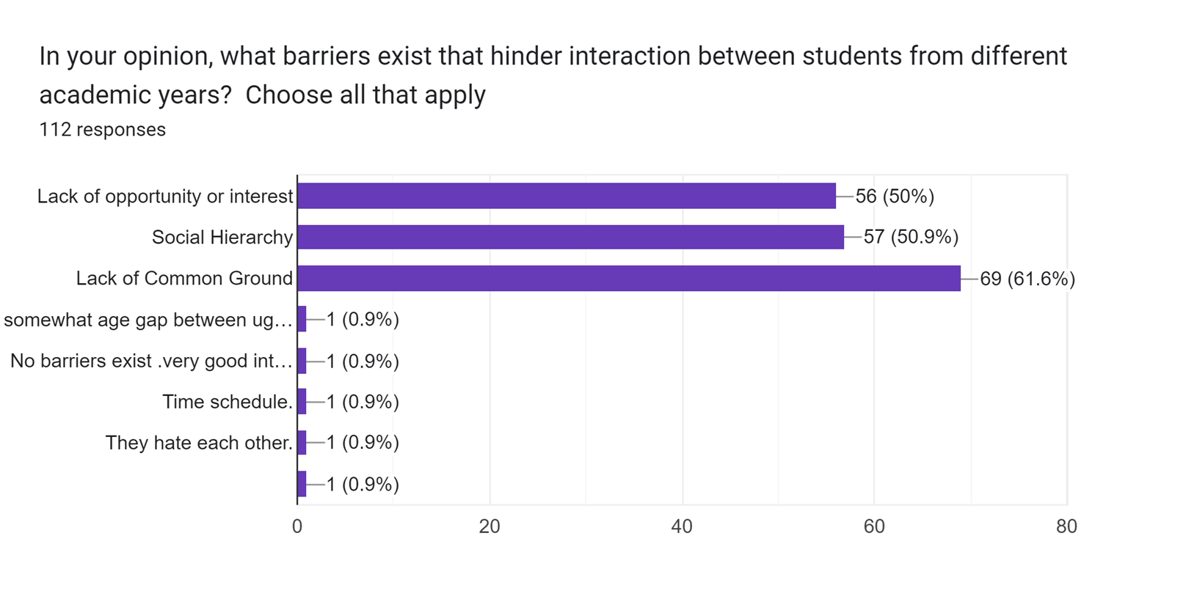
COMMUNICATE COLLABORATE CREATE
Evidence Through Survey

Slide 8



01
Enhancing academic and personal development
The Need for Change
02
Building a cohesive community
03
Fostering inclusivity and support

Slide 9

Empowering Connections: Our Mission
Importance of mentorship
Creating a platform for student-senior interactions
Our ultimate goal: A nurturing, collaborative environment

Slide 10


AIMS AND STRATEGIES
Creating interactive platforms and forums
Implementing mentorship programs
Organizing social and academic events

Slide 11
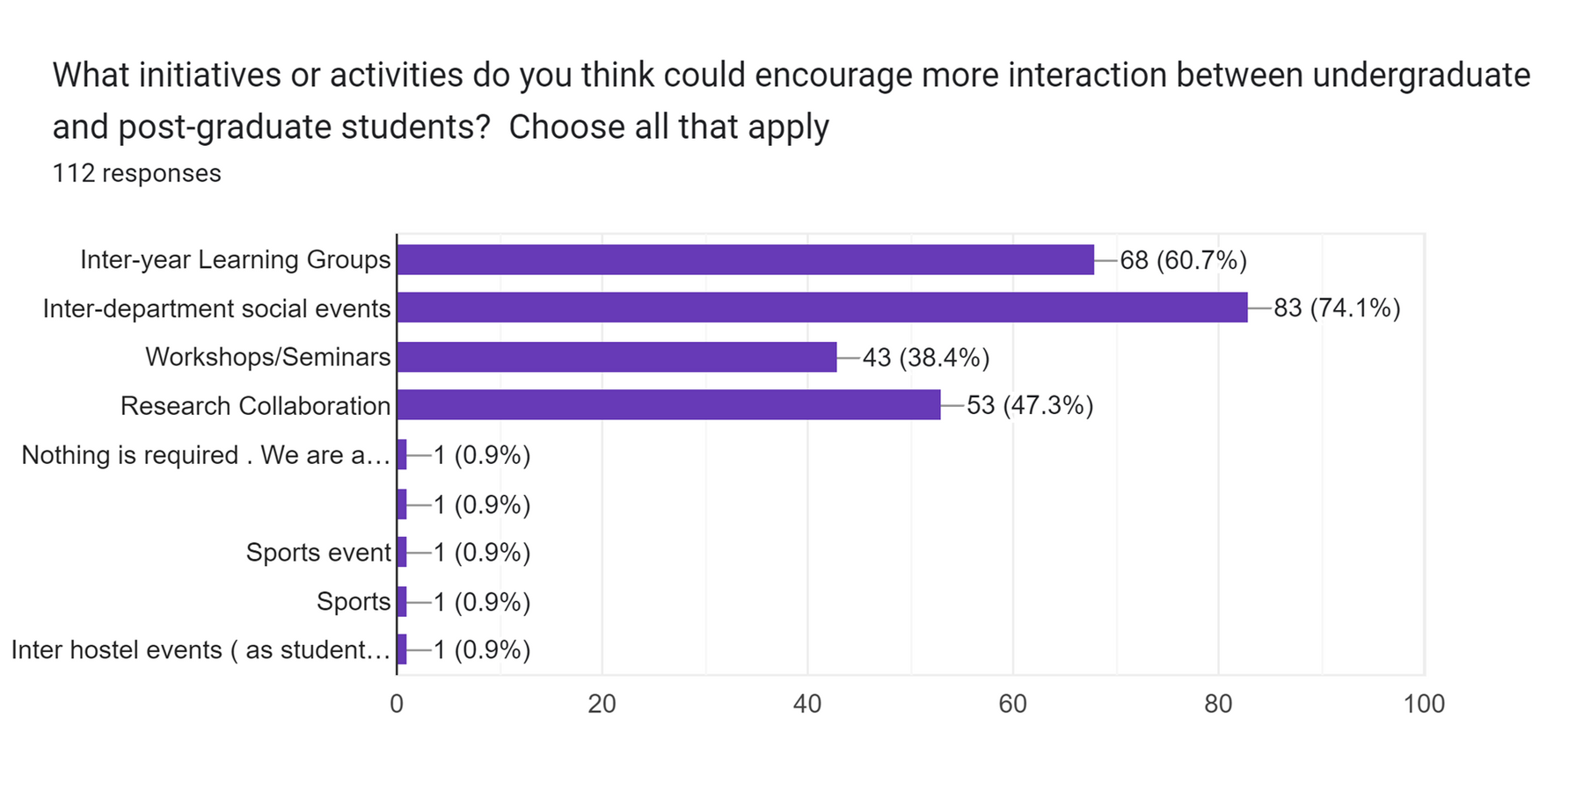
COMMUNICATE COLLABORATE CREATE
Evidence Through Survey

Slide 12
OUR APPROACH
Step 1
Establish an Inter-Year Connect Committee
Request dedicated seniors to volunteer as mentors for the program
Step 2
Invite willing students from the second year and above to choose a domain or area of interest
Step 3
Create dedicated WhatsApp channel and develop a website for the program
Step 4
Facilitate the registration process for students and initiate the program
Step 5

Slide 13

TECHNOLOGICAL INTERVENTION AND NOVELTY
01
WhatsApp groups and website creation
02
Competition notifications and lab visits
03
"Chai pe Charcha" and other events
04
Nothing like this pre-existing in our college
The proposed intervention innovatively merges technological tools with traditional mentorship methods
05

Slide 14
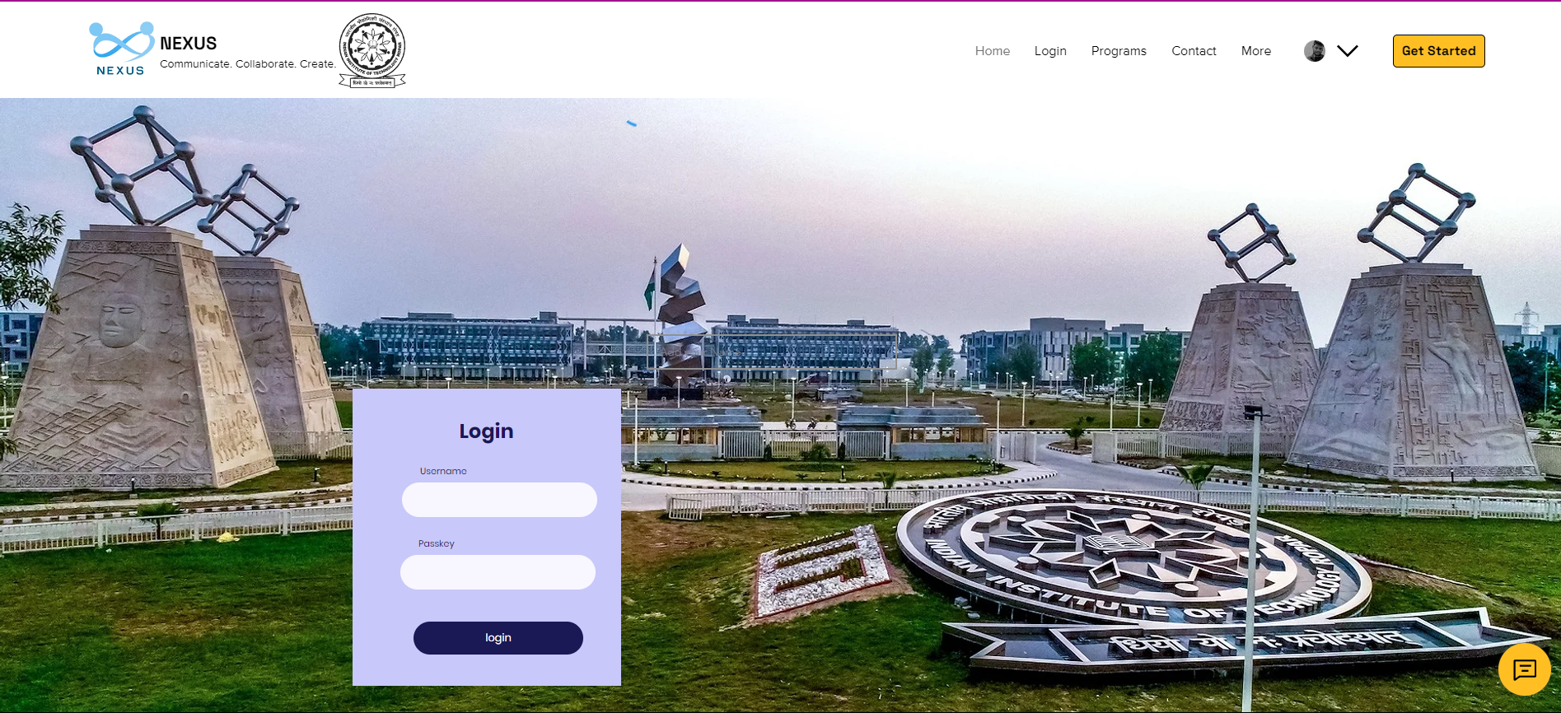
Website Home Page

Slide 15
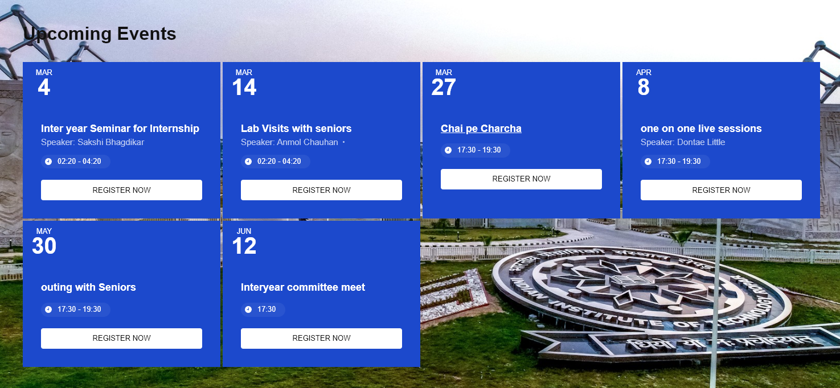
Calender and Upcoming Events

Slide 16





NAVIGATING CONSTRAINTS
Anticipated resistance
Technical Challenges
Limited resources and funding

Slide 17
TOGETHER, WE CONNECT
COMMUNICATE COLLABORATE CREATE

Slide 18
THANK YOU

